Slide 1

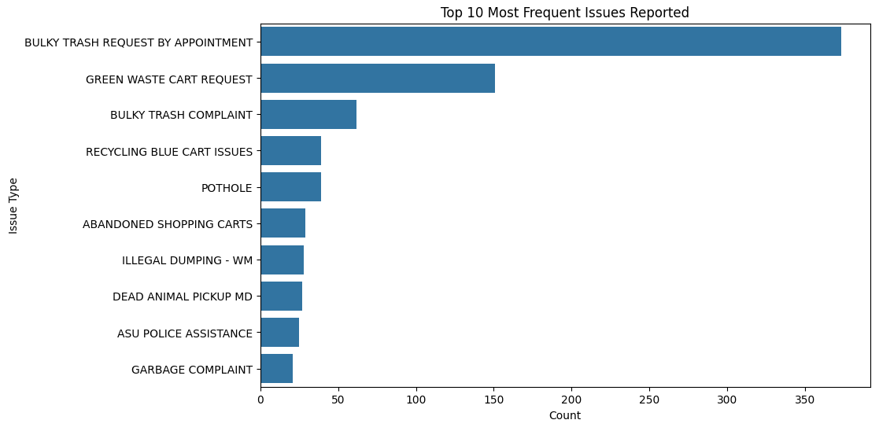
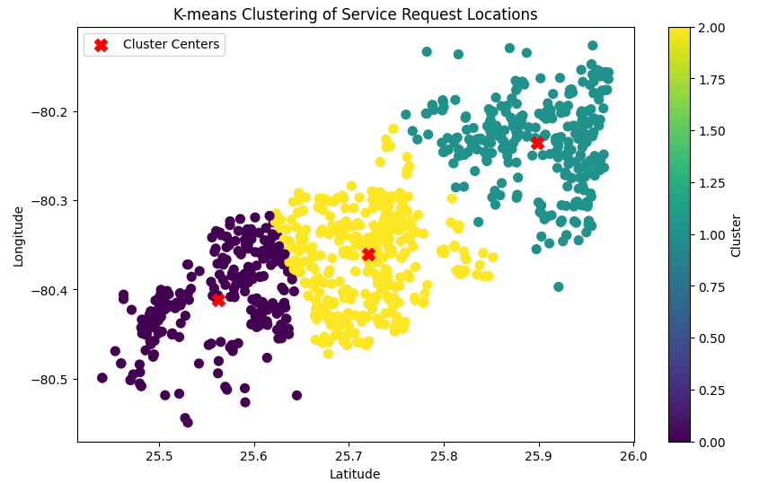
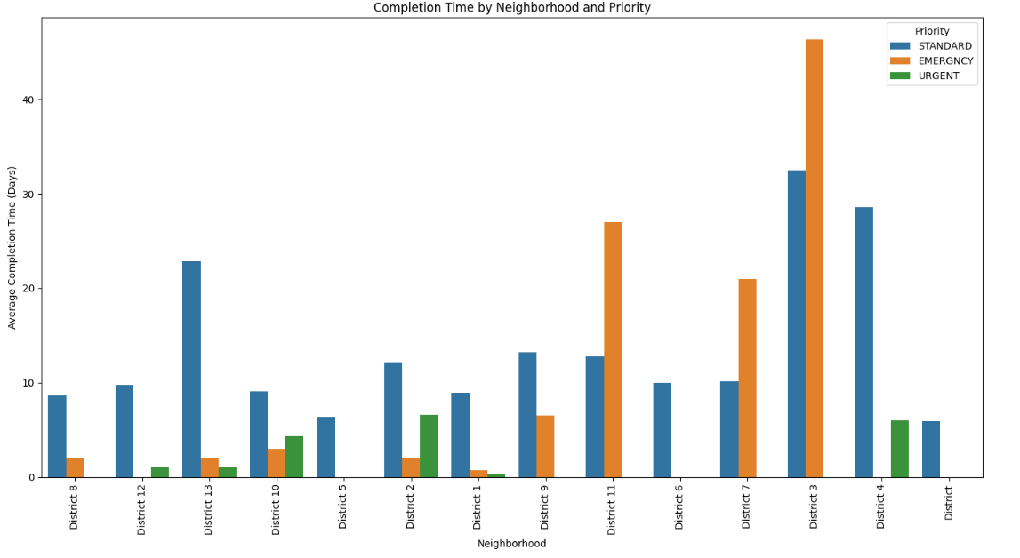
Optimizing Public Service Delivery: A Data-Driven Approach in Miami-Dade County
Authors: Laura Cerpa & Jorge Montalvo
Miami Dade College - Kendall Campus, Miami, FL
Introduction
Results
Results Continued
The Miami-Dade County 311 Contact Center serves as a critical resource for residents, handling over 1.5 million calls and 30,000 emails annually in various languages. With a strong focus on accessibility, the center addresses more than 330,000 service requests each year, providing support through both in-person and online channels.
Our analysis of the 2023 service records from the 311 Contact Center revealed important insights into service request trends, distribution across neighborhoods, and completion time patterns. Using data-driven techniques, we aim to streamline resource allocation, enhance public service delivery, and improve the quality of life for Miami-Dade County residents.
Figure 1: This bar chart illustrates the top 10 most frequently reported issues in Miami-Dade County based on 311 service requests in 2023.
Figure 3: This plot shows the spatial clustering of service request locations in Miami-Dade County using K-means clustering. Each point represents a service request location, with different colors indicating the cluster it belongs to. The red "X" markers signify the centroids of each cluster. The visualization reveals three distinct clusters, pointing to areas with high service demand and potential resource allocation challenges.
Methods
Conclusion
Data Collection: Retrieved service records from the Miami-Dade County 311 Contact Center for the year 2023 through an API.
Data Preprocessing: Cleaned the data by resolving missing values, standardizing data types, and eliminating redundant columns.
Exploratory Data Analysis (EDA): Conducted EDA with descriptive statistics and visualizations to identify trends. This process revealed common service requests and their distribution across different neighborhoods.
Data Mining Techniques: Applied K-means clustering to group service requests based on their locations. The optimal number of clusters was determined using the elbow method. This clustering approach helped pinpoint areas with high service demand.
Analysis Tools: Utilized Python and various libraries like Pandas, NumPy, Matplotlib, Seaborn, and Scikit-learn for data processing, visualization, and machine learning.
Our analysis of Miami-Dade County's 311 service data revealed considerable variations in completion times by neighborhood and priority level. For example, emergency requests in District 3 took an average of 46.3 days to complete, while standard requests in District 4 were completed in an average of 28.5 days. These differences were further highlighted when examining the top 10 completion times by neighborhood and priority, revealing disparities in response times, particularly in areas with a higher volume of emergency requests.
By applying K-means clustering, we identified three distinct clusters of service requests, indicating regions with high demand and resource allocation challenges. The data also showed that bulky trash pick-up requests were the most common, underscoring the need for improved waste management services. The longer completion times in neighborhoods with more emergency requests suggest issues with resource allocation or prioritization. This insight into spatial clustering can guide county commissioners in prioritizing resources and planning services for specific communities, ultimately enhancing public service delivery.
References
Figure 2: This column chart displays the average completion time of service requests across different neighborhoods and priority levels in Miami-Dade County. Each bar represents a neighborhood, with different colors indicating the priority level of the service request (emergency, standard, or urgent). The y-axis represents the average completion time in days, while the x-axis represents the neighborhood districts.
Miami-Dade County 311 Service Requests Data, 2023. Retrieved from Miami-Dade County GIS Open Data
Miami-Dade County Public Information Guide. Retrieved from Miami-Dade County Official Public Information Guide

